Slide 1
UNSUPERVISED LEARNING
Density Based Spacial Clustering of Applications with Noise
(DBSCAN)

Slide 2
What is unsupervised learning?
It is a ML technique in which the machine is trained using information that is unlabeled and allowing the algorithm to act on that information without guidance.
The machine understands the patterns and categorizes the data based on the similarities of the patterns.
The output of an unsupervised ML technique unlike a supervised ML technique is not labelled data but different clusters.

Slide 3
What is DBSCAN?
It is an unsupervised ML algorithm that classifies points which are close together as clusters and those that are far apart to be noise or outliers.
Dense regions = clusters
Lonely points = noise

Slide 4
It solves the problem of K-mean scan which are:
Choosing number of clusters beforehand.
K-Means struggles with weird shapes
sensitive to outliers
DBSCAN:
Automatically discovers cluster counts
Handles weird shapes
Detects outliers or noise

Slide 5
The two parameters to consider when using DBSCAN are:
Epsilon:
It says how close should points be to be considered neighbours. It defines the neighborhood radius. It controls what “close together” means.
Note:
There is no universal formula that gives the perfect eps.
Choosing a too small eps will cause many tiny clusters.
Choosing a too large eps will cause everything to be in one cluster
If d <= eps, then same cluster

Slide 6

2. MinPts:
It shows how many nearby points are needed to form a dense region which will eventually be a cluster, ie, the min amount of points close by to be considered a cluster.
A common rule: $$min_pts ≥ dimension + 1$$

Slide 7
Points are classified into 3 types, namely:
Core Points: It has enough nearby neighbors, i.e It is the heart of the cluster.
Border Points: They are close to the core points but do not have enough neighbors themselves.
Noise points: They are isolated, not dense enough and not near a core point. Usually enoted by -1.

Slide 8
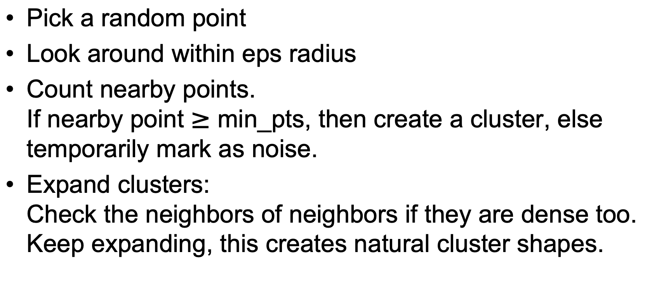
Step - by - step DBSCAN process
Pick a random point
Look around within eps radius
Count nearby points. If nearby point $≥$ min_pts, then create a cluster, else temporarily mark as noise.
Expand clusters: Check the neighbors of neighbors if they are dense too. Keep expanding, this creates natural cluster shapes.

Slide 9
Consider the points below,
A(1, 2) B(2, 1) C(2, 3) D(3, 2) E(8, 8) F(9, 8) G(8, 9) H(9, 9) I(25, 80)
Use the above steps to determine the clusters with the help of eps and min_pts, and if there is any noise or outlier point.

Slide 10
Real life applications
Fraud Detection: Unusual transactions become noise.
Social Networking: Grouping users with similar behavior.
GPS/ Maps

Slide 11
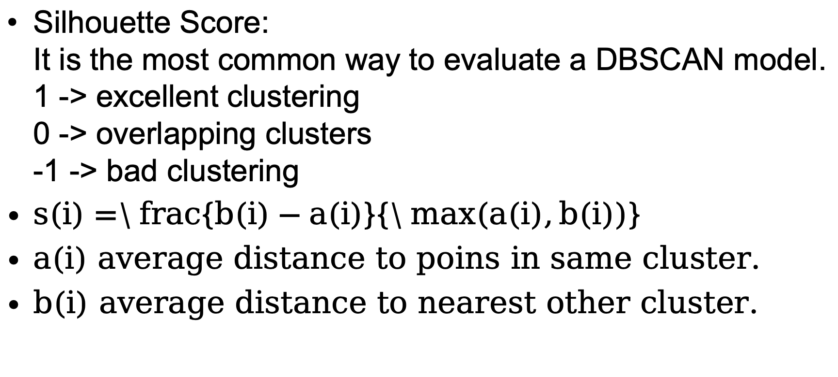
Evaluating the DBSCAN model
Silhouette Score: It is the most common way to evaluate a DBSCAN model. 1 -> excellent clustering 0 -> overlapping clusters -1 -> bad clustering
$s(i)=\backslash frac\{b(i)−a(i)\}\{\backslash max(a(i),b(i))\}$
a(i) average distance to poins in same cluster.
b(i) average distance to nearest other cluster.

Slide 12
A supermarket wants to discover groups of customers based on: Annual income, Spending score
With an eps of 1.5 and a min_pts of 5 use the DBSCAN algorithm to train this model

